Slide 1



Slide 2
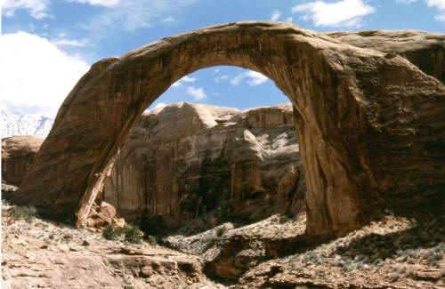
Weathering
The breakdown of the materials of Earth’s crust into smaller pieces.

Slide 3
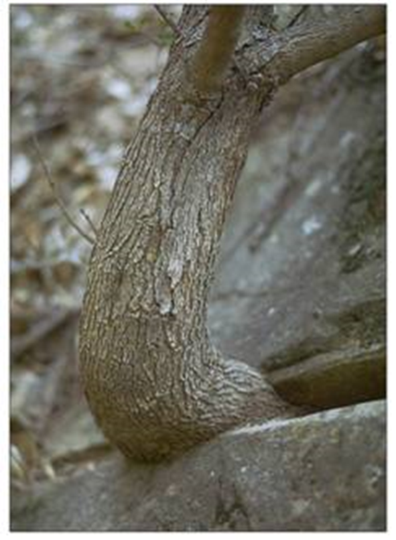
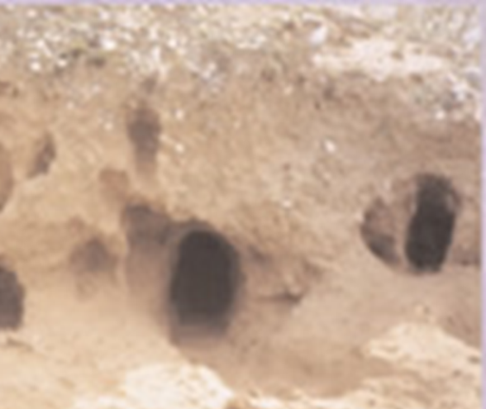
Physical Weathering
Process by which rocks are broken down into smaller pieces by external conditions.

Slide 4
Types of physical weathering
  Ice (including glaciers)
  Plant roots
  Friction and impact
  Burrowing of animals (making dens)
  Temperature changes

Slide 5
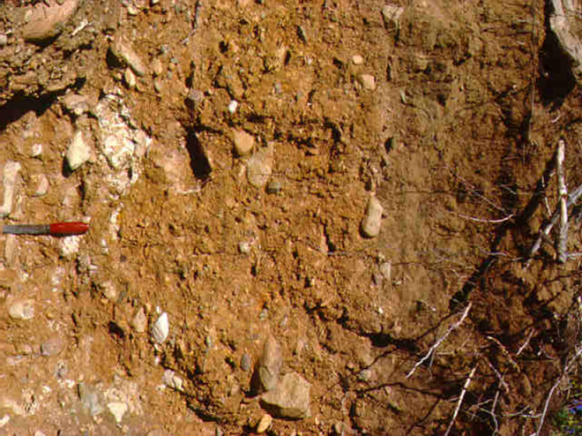
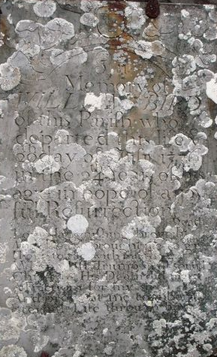
Chemical Weathering
The process that breaks down rock through chemical changes.
The agents of chemical weathering
  Water
  Oxygen (oxidation/rust)
  Carbon dioxide
  Living organisms like lichen
  Acid rain

Slide 6
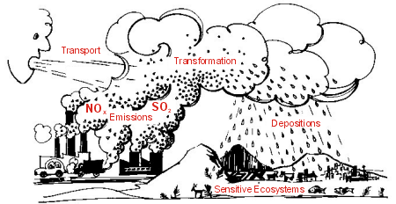
Acid Rain
Compounds from burning coal, oil and gas react chemically with water forming acids. Acid rain causes very rapid chemical weathering

Slide 7

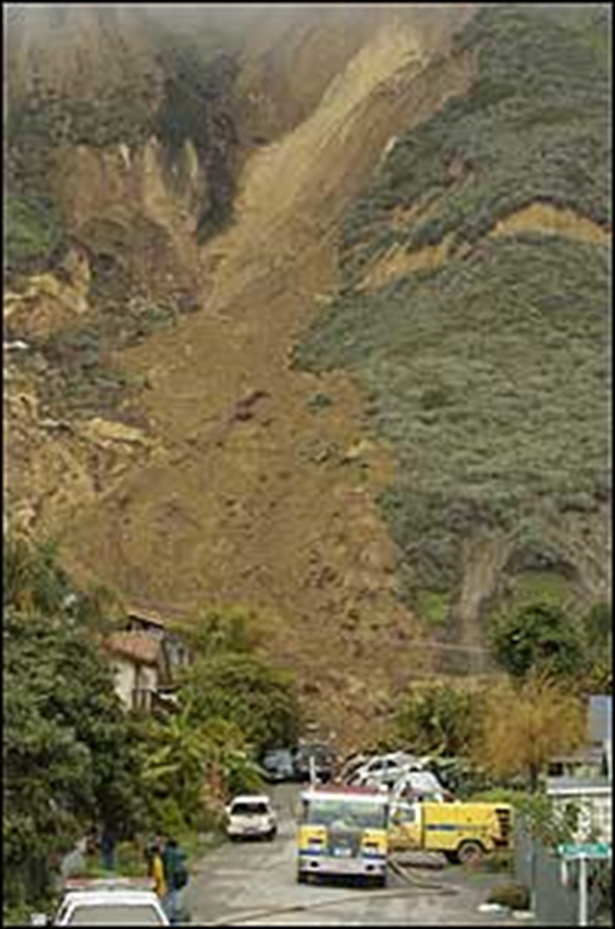
Erosion caused a landslide on the side of this mountain. It destroyed the houses at the bottom.

Slide 8
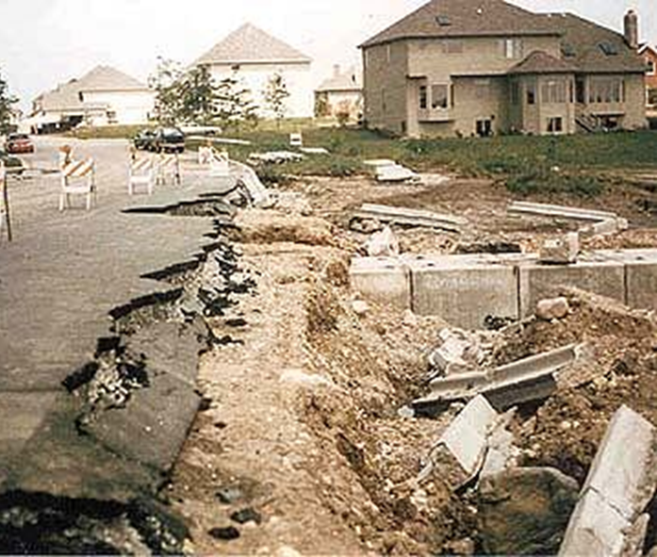

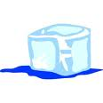

What is Erosion?
The process by which water, ice, wind or gravity moves fragments of rock and soil.
Erosion is the removal of rocks and soil by wind, water, ice and gravity (AKA the agents of erosion)

Slide 9
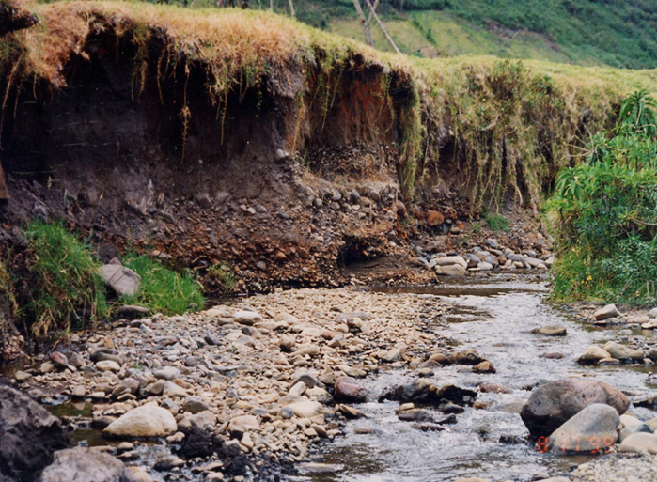
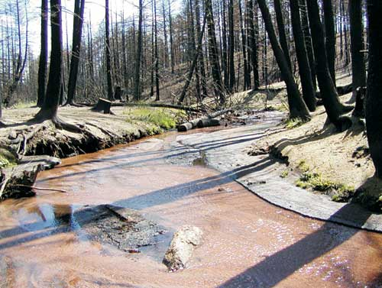
Water Erosion
When rain falls to the Earth it can evaporate, sink into the ground, or flow over the land as runoff. When it flows over land, erosion occurs. Runoff picks up pieces of rock and "runs" downhill cutting tiny grooves into the land.
Rivers, streams, and runoff

Slide 10
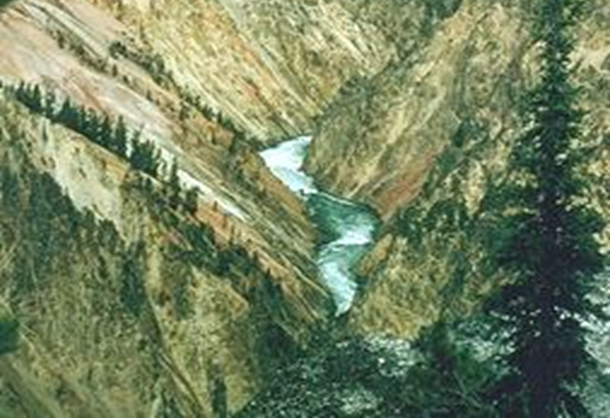
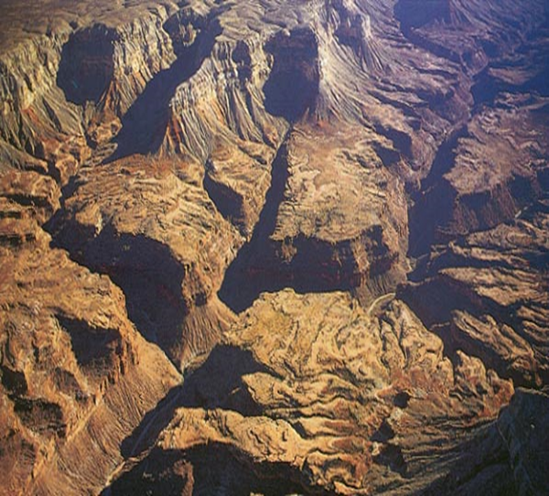
Water erosion
Water flows downhill. The speed of water flow depends upon the slope.
As slope increases, the velocity or speed of the water increases. Rock takes longer to erode than sand or silt.

Slide 11
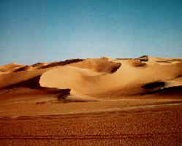
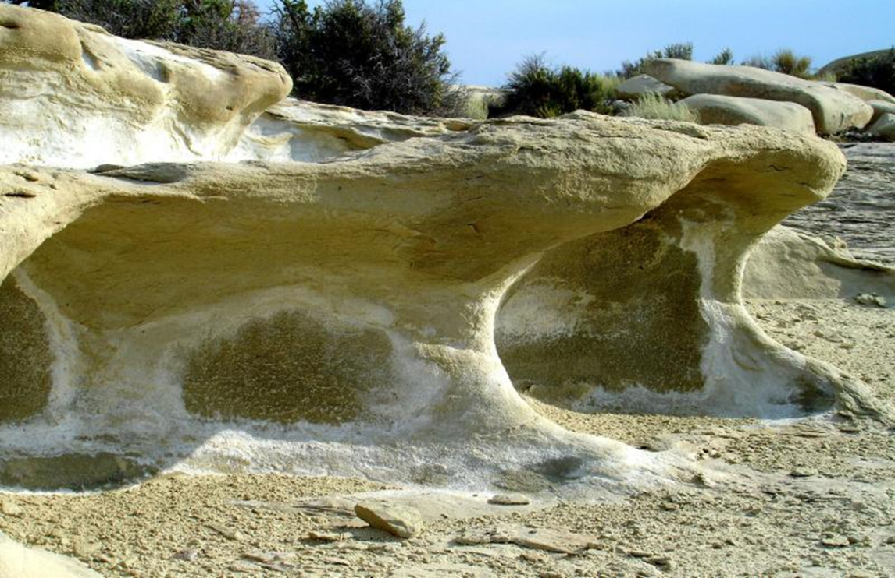
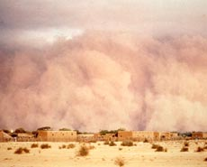
Wind Erosion
As the wind blows, it picks up small particles of sand and sediment and blasts large rocks it. Over time this changes the shape of the rocks and makes them smaller.

Slide 12
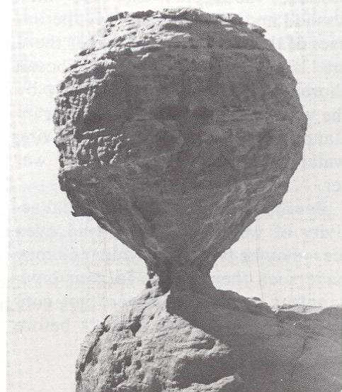
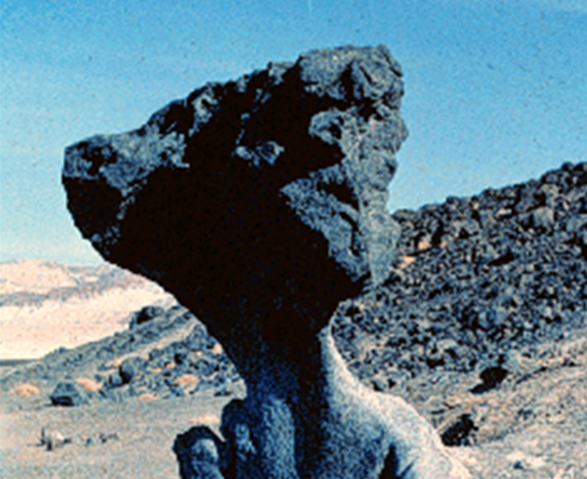
Desert rocks have more erosion close to their base because particles blown by the wind remain close to the ground.

Slide 13
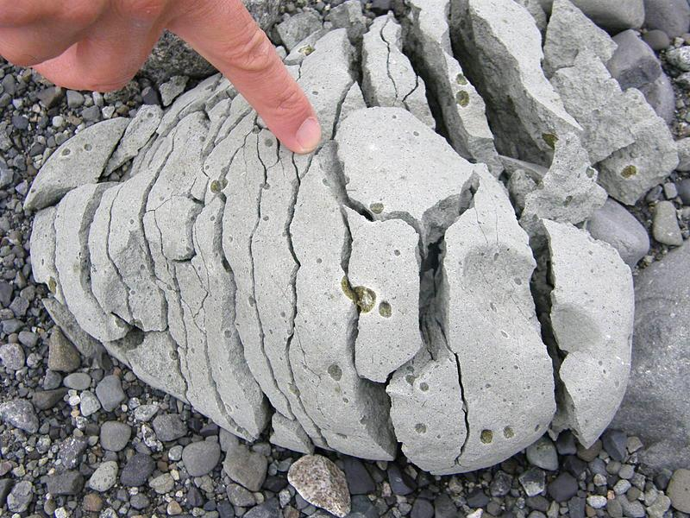
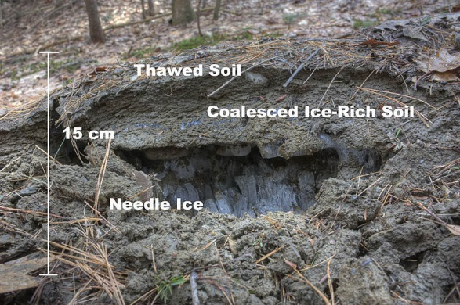
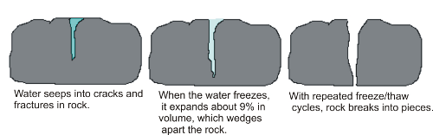
Ice erosion

Slide 14
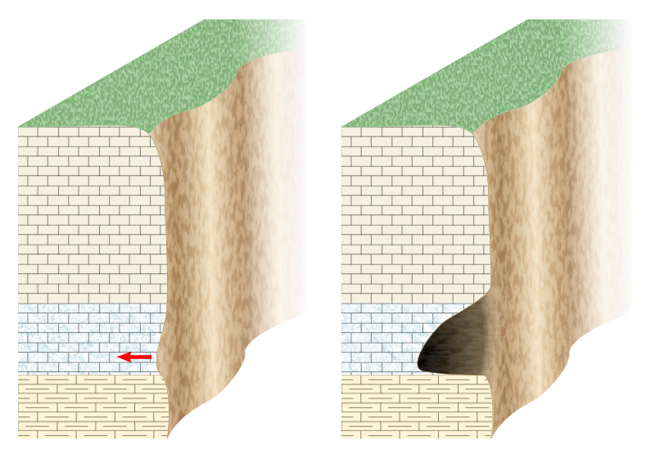
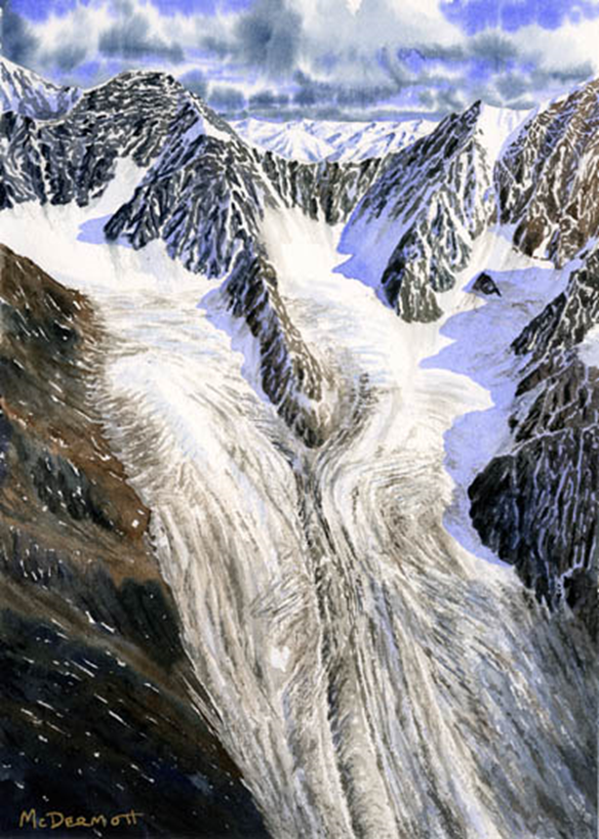
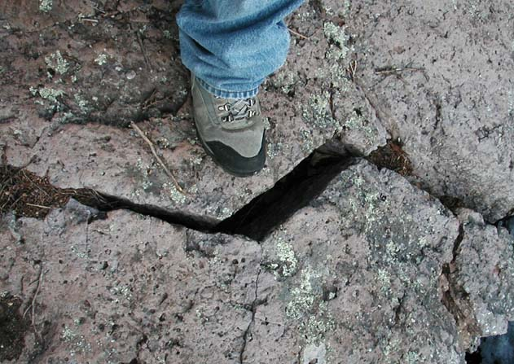
Glacier & ice erosion

Slide 15
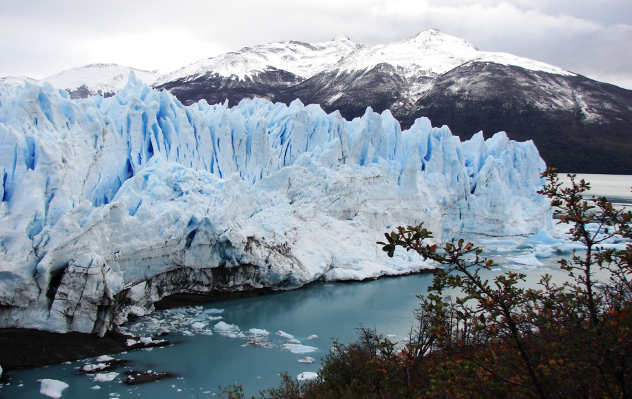
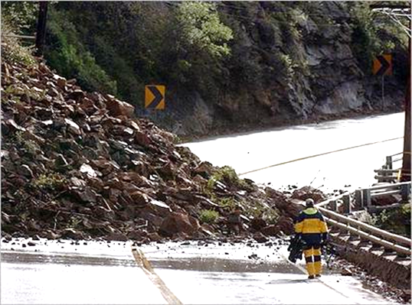
Mass movement caused by gravity
Glaciers pick up and carry tiny sand grains or boulders bigger than a school bus. As it moves like a conveyor belt or a bulldozer, a single glacier can move millions of tons of material!
Landslides, mudslides and glaciers

Slide 16
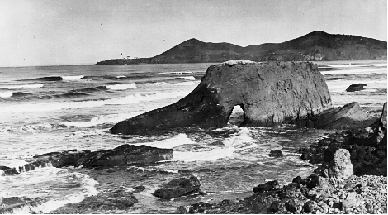
Math connection
Observe how over time the rock erodes. Pay attention to the dates. You can subtract to see how many years passed between pictures..
1890

Slide 17
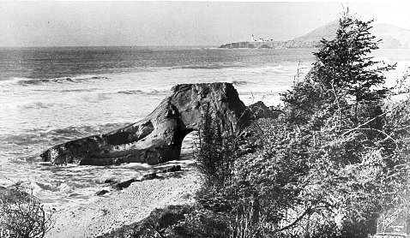
Erosion
Still the same rock but in 1910.
01910
-1890

Slide 18
Erosion
Still the same rock but in 1910.
01910
-1890
20

Slide 19
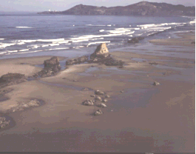
Erosion – stage 4 in 1970

Slide 20
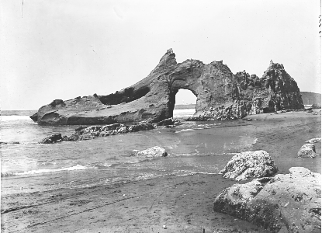
Erosion – stage 3
(notice how the tide is out)
1920

Slide 21
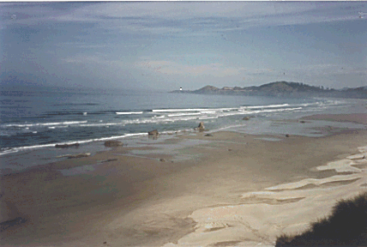
Erosion – 1990
(100 years later)

Slide 22
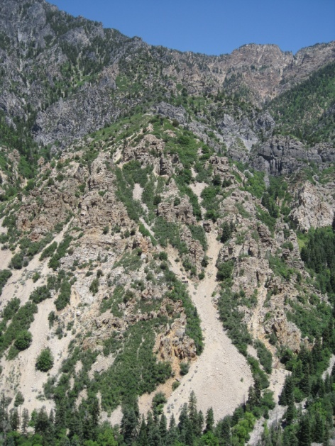
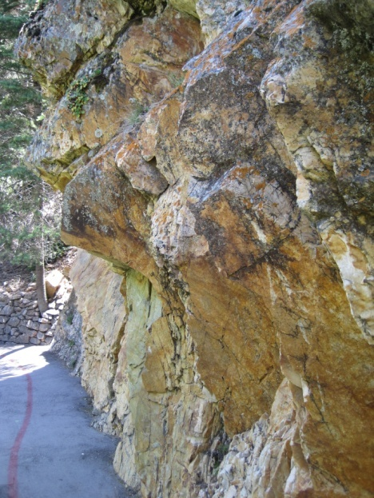
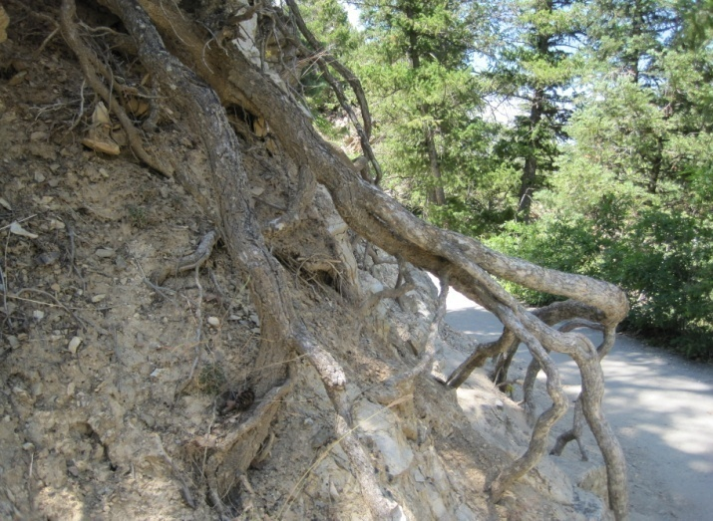
Weathering vs. Erosion
Weathering involves two processes
[physical and chemical]
that often work together to break down rocks. Both processes occur in place. No movement is involved in weathering.

Slide 23
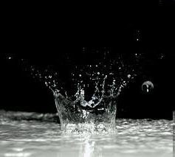
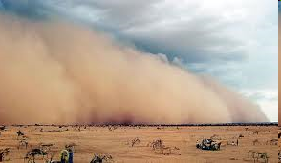
Erosion
Erosion is the movement of rock material from ONE PLACE to ANOTHER.
Three main causes of erosion:
Water, wind, and glaciers

